Slide 1





Belgorod region government
REC
“Innovative Solutions in Agri-business”
World–class research
and education centre (REC)
Innovative Solutions in Agri-business
2020

Slide 2



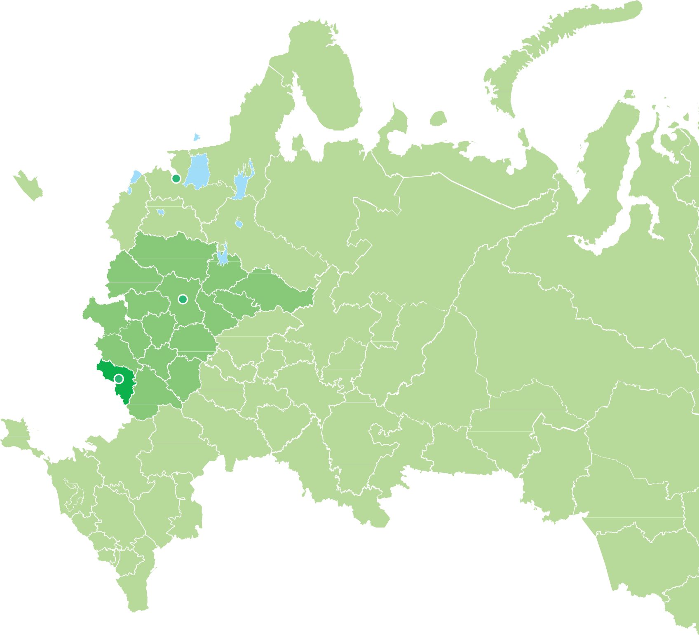
Belgorod region
Belgorod region government
REC
“Innovative Solutions in Agri-business”
formed January 6, 1954
2713,4 k hectares
Total area
2134,3 k hectares
of farmland
(1% of Russia's total farmland)
1511,7 k hectares
of arable land
(1,3% of Russia's total arable land)
St. Petersburg
77%
Region population
1,547,4 k
(1,1% of Russia`s total
population)
Moscow
˜
Belgorod
of farmland consists of Chernozem soils
2

Slide 3

Belgorod region's share
Belgorod region government
REC
“Innovative Solutions in Agri-business”
in Russia's total agricultural production
5%
7,5%
of industrial agriculture
12%
of the Russian meat market
20%
of meat products
of Russia's gross agricultural output
Over 4%
Of the total national agricultural production
18%
of pork
12%
of poultry
19%
of compound feed
13,7%
of condensed milk
Over 1,5%
Of the national export of agricultural products
9,5%
of vegetable oil
12,4%
of spreads
7%
of beet sugar
11,3%
of mayonnaise
6,9%
of premixes
4%
of chocolate and pastries
3

Slide 4
















Uniqueness of Belgorod REC
Belgorod region government
REC
“Innovative Solutions in Agri-business”
REC “Sustainable Mineral Resources Management”
Answering to the major global challenge (feeding people)
Human Capital Development Lab
First-class employer
Innovative growth area for economy
REC “Techno- platform2035”
REC
“Innovative Solutions in Agri-business”
Favourable geographic location for international partnerships
Competitive innovations:
Global eﬀect of REC Formation of new sociocultural, ideological and communicative connections between science, business and government
REC
“Kuzbass”
HERMETIА
KWS
SaKa Pﬂanzenzucht GmbH & Co. KG (Solana-Gruppe)
West Siberian REC
Matthiessen
Hexis
Sunﬁre
4

Slide 5
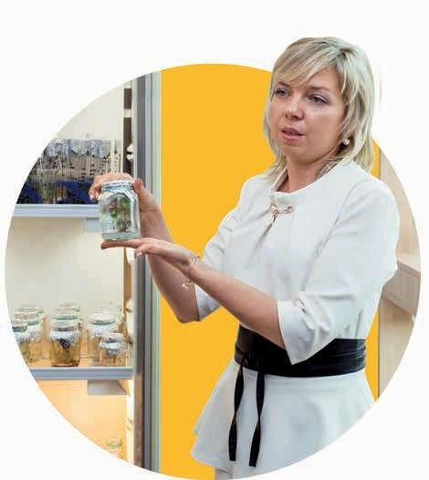
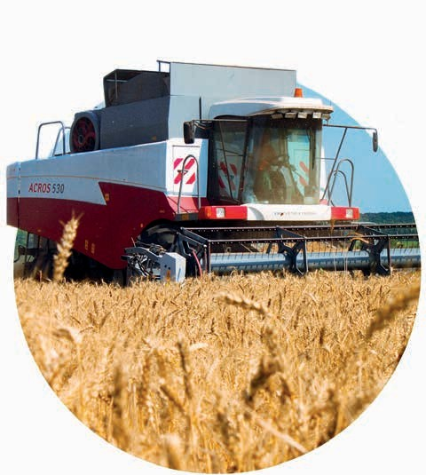





Priority goals of research
Belgorod region government
REC
“Innovative Solutions in Agri-business”
and education centre
Development in compliance with the national priorities in research
Increase of the agricultural industry potential due to commercialization of the
Development of the education
system to train highly qualiﬁed staff for agricultural sector
and technology
research results
5

Slide 6
Cooperation of REC
Belgorod region government
REC
“Innovative Solutions in Agri-business”
participants
Premix plant №1
Prioskolie Group
Commersialization
Belgorod State Technological University named after V.G.Shukhov
Belgorod State Agricultural University named after V.Ya. Gorin
Technologies, products and services
Start-ups
“Boiling point”
NTC BIO
Belgorod State University
EFKO Group
Education Market
Programs
Post graduate, master and continued education
Stary Oskol Branch of MISIS (Moscow Institute of Steel
and Alloys)
Belgorod State Agricultural Research Centre of the Russian Academy of Sciences
Staff training
Agro Belogorie Group
AO VladMiVa
6

Slide 7



























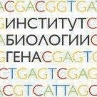




More than 50 scientiﬁc
and industrial partners
Belgorod region government
REC
“Innovative Solutions in Agri-business”
UNIVERSITIES
and other higher educational institutions
RUSSIAN RESEARCH INSTITUTES
(including Institutes of Russian Academy of Sciences)
REC PARTICIPANTS +
7

Slide 8
Organizational structure of
the research and education centre
Belgorod region government
REC
“Innovative Solutions in Agri-business”
Supervisory board
Chair – Governor of Belgorod region
Management board
Research and production platforms (RPP)
under the direction of Russian Academy of Sciences
Bio-technologies
Chief Advisor
Genetic-selection research, cellular technologies and genetic engineering
(Plant breeding)
Chief Advisor
Genetic-selection research, cellular technologies and genetic engineering (Animal breeding)
Chief Advisor
Health protection, food and veterinary drugs production
Chief Advisor
Sustainable use of natural resources
Chief Advisor
Project office
PROJECT PORTFOLIO
Project teams
Technologies transfer
Corporation “Razvitie”
8

Slide 9






Research
and production platforms
Belgorod region government
REC
“Innovative Solutions in Agri-business”
31
5 7
5
PROJECTS
of full cycle
Bio-technologies
Genetic-selection research, cellular technologies and genetic engineering
(Plant breeding)
Genetic-selection research, cellular technologies and genetic engineering (Animal breeding)
9
5
Health protection, food and veterinary drugs production
Sustainable use of natural resources

Slide 10



2024
Belgorod region government
REC
“Innovative Solutions in Agri-business”
15
New assets of infrastructure
Resource Sharing Center
Research Institute
of Genomic Selection
Centre of Agricultural Engineering and End-To- End-Technologies
AgroTechnopark
Others

Slide 11

Educational Goal of the research
Belgorod region government
REC
“Innovative Solutions in Agri-business”
and education centre
Development of the staff training system based on the new educational platform
+15 +20
programs master, post-graduate level
programs continued education
200
Doctors of Science
500
Candidates of cience
2500
Undergraduate and post-graduate students
Centre for competences development
Dissertation council

Slide 12
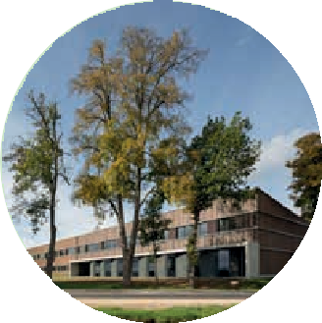
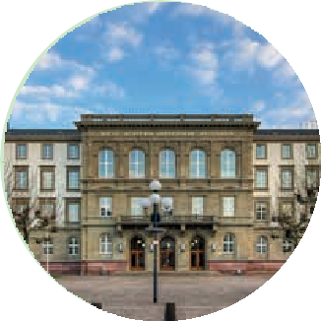

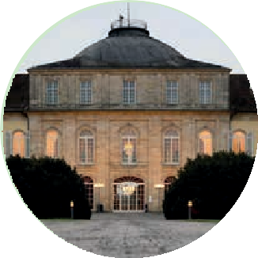




Partners of Belgorod REC
and companies submitted in Belgorod region
Belgorod region government
REC
“Innovative Solutions in Agri-business”
Weihenstephan-Triesdorf University of Applied Sciences
Justus Liebig University Giessen
DEULA-Nienburg
German School
of Agricultural Engineering
Universität Hohenheim
SPF RUS, LLC SYMRISE AG
Dr. Oetker
Hochland
ZMS-TЕCHNOLOGY

Slide 13




Innovative technologies
Belgorod region government
REC
“Innovative Solutions in Agri-business”
Technology of microbiological L-threonine synthesis
Technologies for new biological products based on biologic synthesis
Growth stimulators and crop protection agents based on metal nanoparticles
Technology of three-phase soy hulls fermentation
Platform with intellectual artificial vision for animal condition monitoring
Technology of production of protein sugar substitute

Slide 14




Industrial application of competitive technologies generated by REC
Belgorod region government
REC
“Innovative Solutions in Agri-business”
L-threonine production plant with annual capacity of
16 000 tons
Protein meal production plant with
2840
tons capacity
by 2024
Soy hulls fermentation plant with daily capacity of
100 tons
Sugar substitute production plant with daily capacity of
100 kg

Slide 15
Indicators
of implementing the research and education centre program
Belgorod region government
REC
“Innovative Solutions in Agri-business”
+3000 25%
50% +120
new high-tech workplaces
increase in share of advanced high-tech products in the total amount of shipped products
researchers aged 39 in the total number of researchers
patents for inventions

Slide 16
Prospective outcomes
Belgorod region government
REC
“Innovative Solutions in Agri-business”
>15
+20% 25%
> 2.5 times
billion rubles
FINANCING
gross regional product
in comparable prices on 2018
1.2 trillion rubles
increase in innovative activity of businesses
volume of exports
of agri-business products
>2.5 billion US $

Slide 17
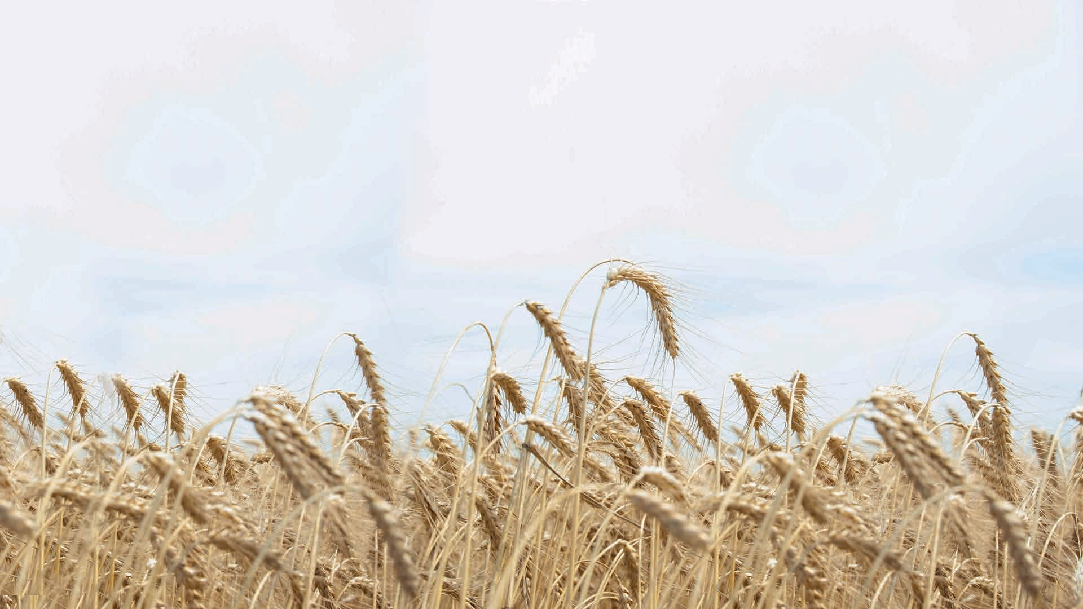
Belgorod region government
REC
“Innovative Solutions in Agri-business”
Thank you
for your attention!

